Slide 1
Real-Time Programming (III)

Slide 2
Topics
Pre-Period deadlines
Interrupts
  Interrupts and Interrupts Handlers
  Priority Interrupts and Nested Interrupts
Priority Inversion (if time allows)

Slide 3
Pre-period deadlines

Slide 4
Overview
In following, we will study more practical issues in the application of GRMS:
  Pre-period deadlines
  high priority I/O
  interrupts
Notes:
2

Slide 5
Review: Context Switch Time
An instance of a periodic task can cause at most two context switches. To simplify the analysis, we shall assume that this is always the case.
In the following example, the time left for t₂ is (150 - 3C₁ - 6S) = (150 - 3(C₁+2S)). Thus we can take the effect of context switching into account by replacing C₁ with (C₁ + 2S) and reuse analysis methods which assume that the context switching overhead is zero.
S S S S S S
」
T₁
C₁
C₁
C₁
0
50
100
T₂
0
150
The context overhead incurred by task τ_{i} is 2S/P_{i}, while the net processor
utilization by task τ_{i} is C_{i} /P_{i..}

Slide 6
Modeling Preperiod Deadlines
Suppose task τ, with compute time C and period P, has a preperiod deadline D.
  In UB tests, pre-period deadline can be modeled as if the task has a longer execution time (C+D), because if the task has execution time (C+D) can finish before time P, then we know it must finish D units before P if it has only execution time C.
  In exact schedulability test, just move the deadline from P to (P - D).
C
D
deadline
P

Slide 7
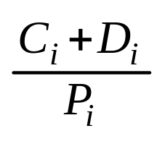
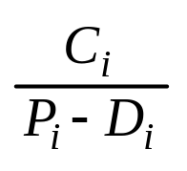
Quiz
We have modeled the effect of pre-period deadline by adding D to execution time C.
It was suggested that we may also subtract D from the period P. What do you think? (Hint: are the 2 methods equivalent? Is there a counter example?)

Slide 8
Counter Example for (P – D)
10
9
5
14
Consider the case of two tasks, {(C₁= 4, P₁= 10), (1, 14)}. If the pre-period is more than 9, then Task 2 will not be schedulable.
However, 4/10 + 1/(14 – 10) = 0.4 + 0.25 = 0.625 < U(2). That is, it tells us that even if the pre-period deadline is at t = 4, it is still schedulable. This is obviously wrong

Slide 9
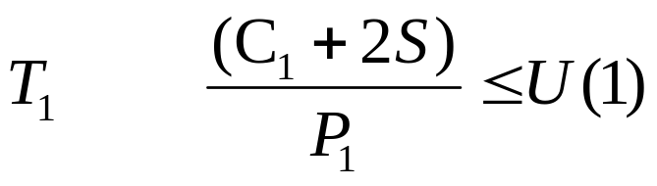
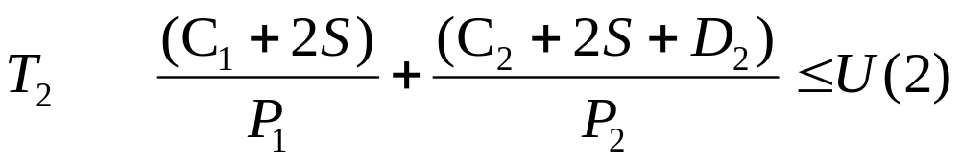
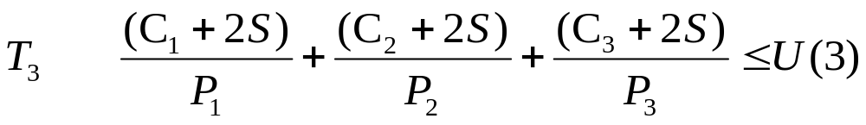
Task Switching and Pre-period Deadline
Suppose that task 2 has D₂ unit of preperiod deadline, we just add D₂ to task 2’s execution time LOCALLY (Why?)

Slide 10
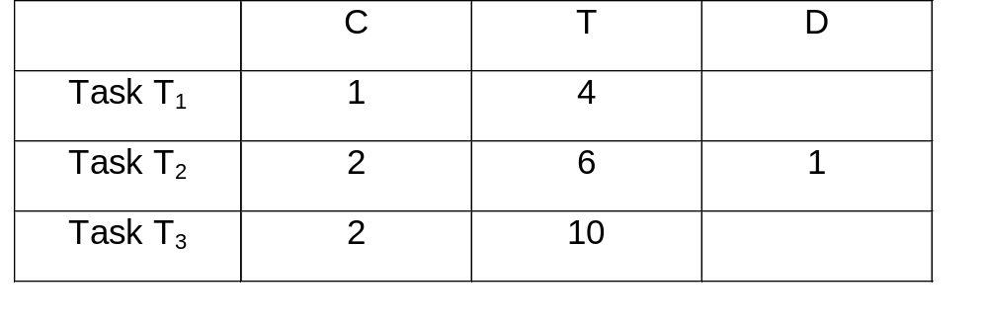
Example: Schedulability with Task Switching and Pre-period Deadline
Given the following tasks:
Assume S = 0.05, are these 3 tasks schedulable?

Slide 11
Solution: Schedulability with Task Switching and Pre-period Deadline
a0 = 1.1 + 2.1 + 2.1 = 5.3
a1 = 2.1 + ceil(5.3/4) * 1.1 + ceil(5.3/6) * 2.1 = 6.4
a2 = 2.1 + ceil(6.4/4) * 1.1 + ceil(6.4/6) * 2.1 = 8.5
a3 = 2.1 + ceil(8.5/4) * 1.1 + ceil(8.5/6) * 2.1 = 9.6
a4 = 2.1 + ceil(9.6/4) * 1.1 + ceil(9.6/6) * 2.1 = 9.6
Task 3 is schedulable, it completes by 10.00

Slide 12
The Concept of Blocking in GRMS
In GRMS, short period tasks are given higher priorities. When a long period task is delayed by the execution of short period tasks, the long period task is said to be PREEMPTED by short period tasks.
What if, for some reason, the long period task delays the execution of short period tasks? In this case, the short period task is said to be BLOCKED by long period tasks.
(NOTE: in OS literature, if a higher priority delays a lower priority task, it is called preemption, independent of periods.)

Slide 13
Blocking Due to I/O and Interrupt Handling
In this example, T₃ has the longest period. However its data I/O executes at top priority to reduce jitter. As a result, T₃‘s data I/O blocks the execution of shorter period tasks, T₁ and T₂.
Data I/O
T₃ I/O
T₁
T₂
T₃ exec
Similarly, if we use interrupts to perform the data I/O, the ISR for data I/O will have higher priority even if it is done for a longer period task

Slide 14
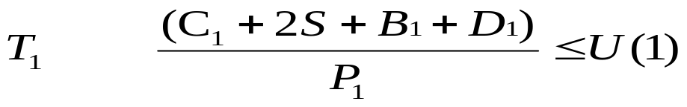
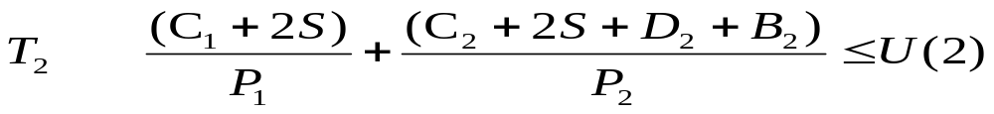
Task Switching and Pre-period Deadline and Blocking
Suppose that a task has D unit of preperiod deadline and blocking time B, we just add them to its execution time for each task in UB test. In exact schedulability test, we will move the deadline from P to (P - D - B).
Note that B₃ is always zero. It is the task with the longest period and therefore
it cannot be blocked by a task with longer period.

Slide 15
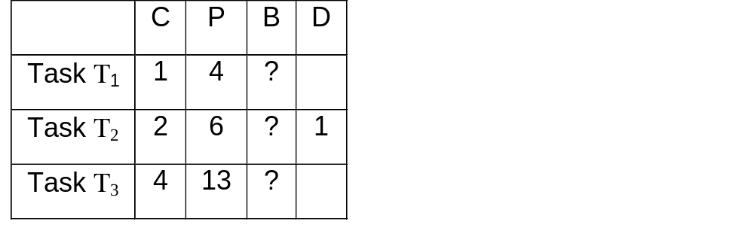
Example: Interrupt and I/O
Suppose that S=0.0. However, task 3 has two parts. part 1 is execution
time C₃ = 1 and part 2 is high priority I/O that is 3 units long.
Fill in the blocking times in the table and determine if all three tasks
are schedulable?

Slide 16
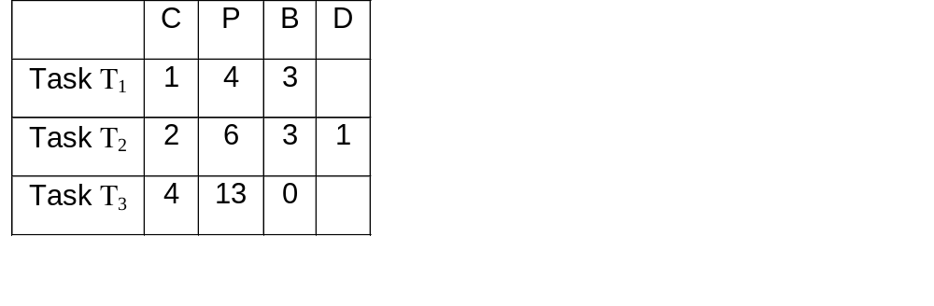
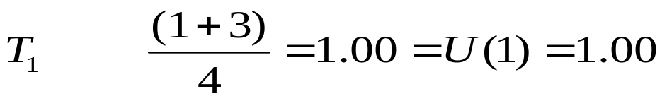


Example: I/O and Interrupts
a₀ = 1 + 2 = 3 > (6 - 1 - 3) = 2. Not schedulable
a₀ = 1+2+4 = 7,
a₁ = ceil(7/4)*1 + ceil(7/6)*2 + 4 = 10
a₂ = ceil(10/4)*1 + ceil(10/6)*2 + 4 = 11
a₃ = ceil(11/4)*1 + ceil(11/6)*2 + 4 = 11<13
(The lowest priority one is ok!!)

Slide 17
Summary
In this lecture, we learned
  how to model pre-period deadline
  the notion of blocking caused by giving longer period task I/O higher priorities
We will study real time task synchronization next.

Slide 18
Interrupts

Slide 19
Why Interrupts are Needed
A detour from normal program execution to handle
slow I/O devices when the CPU is doing something else and responds to
  the keyboard as soon as a key has been pressed and
  printer which it becomes ready to receive new data.
various error conditions
  divide by zero,
  invalid op code,
  stack segment overflow, and
  protection faults: privilege rules violated, write to protected code segment…
What is the difference from interrupt and polling? When to use interrupt and when to use polling?

Slide 20
Simple 8-bit I/O port
Most I/O ports have several modes of configuration
Can be configured to be an input or output by writing to a bit in a status register.
Address, Data and Status Bus
A0 = 0: D0..D7 I/O data
A0 = 1: Data direction register
i.e., if DDR bit 0=0, D0 = input
if DDR bit 0=1, D0 = output
Address Decode
Data
Bus
uP
R/W
CE
A0
INT
8-bit I/O Port
IRQ
Store
D0
D7

Slide 21
Interrupts: Interfacing to the real world
Interrupt: An asynchronous external* input which causes the processor to stop its normal program execution ( interrupt it ) and start executing code from another location
  Called the Interrupt Service Routine (ISR)
Without interrupts, processors would have to spend all their time testing inputs to see if an external device needed to communicate with it
  Called Polling
  Polling is still an acceptable programming technique if the algorithm is regular and allows I/O’s to be tested on a regular basis
    Burglar Alarm Controller is a good example
A good analogy for an interrupt is the ringer on your telephone
  Imagine if the only way to find out if someone was calling you was to pick up the phone and say, “Hello, anybody there?”
* Interrupts may be generate internally as well

Slide 22
Interrupts (2)
Reset: RST
  When power is first applied the internal state machines are randomly configured
  Asserting RESET
    Clears internal registers
    Establishes known conditions
    Begins program execution from a known memory location
Non-Maskable Interrupt (NMI)
  An interrupt which cannot be ignored
  Generally reserved for catastrophic events ( power loss )
Interrupt: (INT)
  Lower priority than RST and NMI
  Can be controlled so that a lower priority interrupt may be ignored while a higher priority interrupt is being service

Slide 23
Interrupts (3): RESET
RESET has two major functions
  1: Establish a known state in the processor so that it can begin to operate properly on power-up
  2: Return an operating processor to the known state if something unexpected happens
    Generally used as part of a Watchdog Timer circuit in high-reliability applications
    Failure to send a periodic signal to the watchdog timer results in a RESET to the processor
Schmitt Trigger
Input
Switching Point
Watchdog
Timer
+Vcc
RST
uP
Output
NOMC
Switch
Resistor
Capacitor
Gnd

Slide 24
Interrupts (4): RESET
MC68000 executes an Exception Vector fetch to begin execution of instructions following the receipt of a RESET signal
  Memory location 0x000000 .. 0x000003 contains the location of the stack pointer (4-bytes )
  Memory location 0x000004..0x000007 contains the location of the program counter
Whatever value is stored in memory location 0x000004..0x000007 is the address of the first instruction to be executed after the RESET is processed
  Called indirect addressing
  In C, this is a pointer

Slide 25
Interrupts (5): Non-Maskable Interrupt
Non-maskable interrupt NMI is the second highest priority interrupt after RESET.
Generally a separate input signal to the processor but may be part of an encoded interrupt (MC68000) request.
Non-maskable means that it cannot be ignored (masked.)
Typical uses of NMI’s are hardware failures, power failures, watchdog timer time-outs.
Different from RESET because it can preserve the state of the processor and recover execution sequence after interrupt is serviced
  RESET assumes that everything is suspect ( power on ) and state of the system prior to the RESET request is not saved.

Slide 26
Interrupts (6): Priority Interrupts
The most general category of interrupts must deal with priority levels
  Allows an interrupt of higher priority to take over from a lower-level priority.
  Generally establish priorities based upon the time criticality of the algorithm or the volatility of the data.
  Example: Reading a disk buffer full of data before the buffer is overwritten is a higher priority than a keyboard input.
Different processors have different mechanisms for handling interrupt priorities
  Combinations of hardware and software methods

Slide 27
Interrupts (7): Priority Interrupts
Example: Daisy chaining
  Higher level interrupts are located closer to the processor
  Devices closer to the processor may block the interrupts from devices further away
Lowest Priority
Highest priority
INT
IN
INT
OUT
INT
IN
INT
OUT
INT
IN
INT
OUT
INT
uP

Slide 28
Interrupts (8): Priority Interrupts
The MC68000 encodes interrupt requests at 7 levels through a 3-bit IRQ method.
  Level 7 is an NMI
If the currently stored interrupt priority level is higher than the new interrupt request priority level, the new interrupt is ignored until the priority level is changed by writing a new value into the Processor Status Register.

Slide 29
Interrupt Model
User program
Save return address
and
flags on stack
Save registers
on stack
Read ISR addr
from INT
vector table
Handle keyboard
input
INT
Restore register
Pop return addr
and flags from stack
IRET

Slide 30
The Addresses of ISRs: Interrupt Vector Table
Interrupt vector table stores the addresses of the ISRs. The interrupt service routine (ISR) are identified by the starting address of the vector.
0000
IP-0
INT 0H: divide by zero
0002
CS-0
0004
IP-1
INT 1H: Single Step
0006
CS-1
IP: instruction pointer
CS: code segment register
Vectors 32 - 255
available to users
INT #H is stored at address: 4 * #H. Thus INT 1H is stored at 0004H

Slide 31
How to Pass An Interrupt Type Number to Computer
Self Service: for CPU logic generated interrupts, e.g., bus error etc.
Software interrupt: you supply the number by using the instruction: INT #H.Could you give me a couple of examples that software interrupts are needed?
Quite often, an external I/O devices generates an interrupt. Again, your are responsible for providing the INT #H.
  The I/O device pulls the interrupt request line INTR
  The CPU responds by acknowledging INTA
  The I/O device clears INTR and puts a 8 bit interrupt number of data bus
  AD0 .. AD7
The interrupt number on the device can be set by an 8 bit dip-switch. It must
  not _______________ be a used one
  have ______________ corresponding Interrupt
  vector table entry & ISR
OR ____________________ will happen. crash

Slide 32
Help Your Computer to Find the Right ISR
Supposed that interrupt number 34H has not been used and we would like to store the ISR at memory location 30400H. Code segment starts at 30000H. That is, we would like the ISR starts with an offset 400H to the segment base adr. 30000H.
  IP = __________H (1)
  CS = __________H (2)
  INT Vector Address = _________ H (3)
  0 PUSHA (4)
  1 MOV DS, 0 (5)
  2 MOV AX, 400H (6)
  3 MOV [D0H], AX //store IP (7)
  4 MOV AX, 3000H (8)
  5 MOV [D1H], AX //store CS (9)
  6 POPA (10)
  There are 2 bugs, can you spot and correct them?
1) 400 H (2) 3000 H 3) D0H (34H*4H)
(5) not allowed (9) D2H (2 byte)

Slide 33
Interrupt Handling Sequence- 1
Since the interrupt is a detour to the normal execution, we need to save the context and jump to interrupt service routine
  Save the content of the status (flag) register by pushing it to the stack.
  Clear the Interrupt (IF) and trap (TF) to disable the INTR pin and the trap for, e.g., single step execution.
  Save the content of the code segment register (CS).
  Save the content of instruction pointer (IP).
  Place interrupt vector’s content to IP and CS (jump to ISR).
0000
IP-0
0002
CS-0
0004
IP-1
IP
0006
CS-1
CS

Slide 34
Interrupt Handling Sequence - 2
Interrupt service routines are responsible to handle the event that causes the interrupt.
They need save the values of the registers before using them
  PUSH AX ; save register AX
  PUSH BX
  Body of Code
  POP BX ; restore register BX
  POP AX
  IRET ; return

Slide 35
Interrupt Handling Sequence - 3
The execution of return from interrupt IRET causes
  the saved flag register is pop and restored
  the saved code segment and instruction pointers are restored.
The program resumes the computation at the point prior to the interrupt.

Slide 36
Summary
We have learned how to
set up the interrupt vector table
how maskable nested priority interrupts work. (note: only the truly highest priority urgent events should use the NMI)

Slide 37
Priority Interrupts and Nested Interrupts

Slide 38
The Interrupt Model
User program
Save return address
and
flags on stack
Save registers
on stack
Handle keyboard
input
Read ISR addr
from INT
vector table
INT
Restore register
Pop return addr
and flags from stack
IRET

Slide 39
Big Picture
Suppose that the ISR starts right at 28000H, the starting address of the code segment.
Interrupt Table Entry
A0 H
0000 H
IP
2800 H
CS
28000H
ISR starts here
(If not, location _________ stores the offset from 28000H)

Slide 40
Example
Suppose that the breakpoint ISR code begins at 30400H
When a user sets a break point at line 17, the compiler inserts “INT 3H” call into the object code of your program, right before the object code generated for line 17.
Before line 17 is executed, the ISR is invoked so that you can see all the values of the variables used by your program right before line 17 is executed. And you can single step line 17 and see what difference does line 17 makes. …
ISR TABLE
load
CH
400H
IP reg
CS reg
3000
30000H
“INT 3H” instructs the computer to go to location C H to look for the ISR’s address that it can execute the ISR
30400H
1st ISR instruction

Slide 41
Hardware Interrupt Type Number
5v
AD0
Buffer
Chip
x86
G
AD8
Gnd
INTR

Slide 42
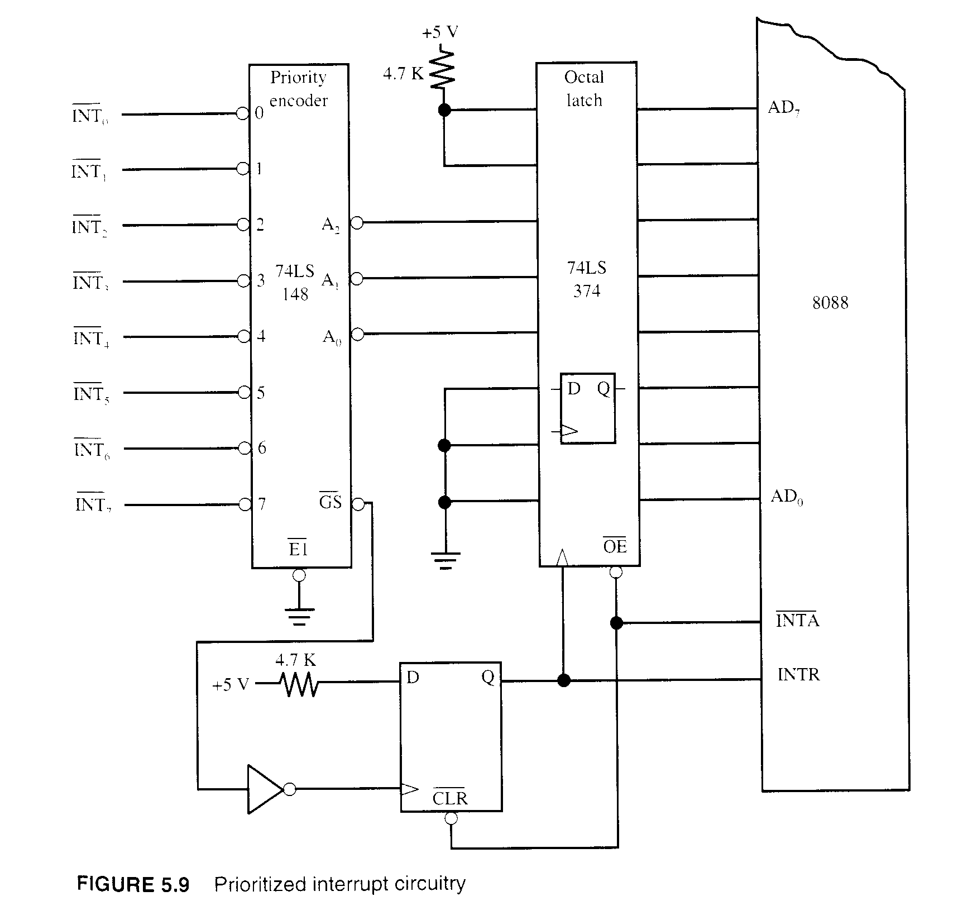
Prioritized Interrupt Basic
When several interrupts are pending, the highest one is selected (largest) by the encoder.
The interrupt type number is 11xxx000.

Slide 43
Nested Priority Interrupt
When a processor is serving a maskable interrupt, it will be interrupted only when there is a newly arrived higher priority interrupt request.
Priority Interrupt Controller Chips
provide a priority mask register to disable interrupt up to any priority level.
provide a interrupt mask register to disable any particular interrupt request line.
Status registers

Slide 44
Nested Interrupts - 1
STI ;set (enable) interrupt flag
CLI ;clear(disable) interrupt flag
Recall from last lecture that when the hardware passes to the control to ISR
  Save the content of the status (flag) register by pushing it to the stack.
  Clear the Interrupt (IF) and trap (TF) to disable the INTR pin and the trap for, e.g., single step execution.
  Save the content of the code segment register (CS).
  Save the content of instruction pointer (IP).
  Place interrupt vector’s content to IP and CS (jump to ISR).

Slide 45
Nested Interrupt - 2
What if we want to enable a higher priority interrupt while serving a lower priority interrupt?
Should we just enable interrupt after we enter the ISR? Why and why not?
Ans: if we execute STI after saving the context in the ISR, the INTR line will be enabled. At this point, any new interrupt, with higher or lower priority can cause a nested interrupt. (not exactly what we have in mind.)

Slide 46
Example: Maskable Nested Priority Interrupt
Supposed priority 3 interrupt arrives first, followed immediately priority level 5 (higher interrupt)
interrupt level 3 ISR
save context AND the old priority mask
set priority mask level 3 (level 3 or lower disabled)
enable interrupt
serving interrupt
interrupt level 5 ISR
save context AND the old priority mask
set priority mask level 5 (level 5 or lower disabled)
enable interrupt
serving interrupt
restore context AND the old priority mask
IRET
serving interrupt
restore context AND the old priority mask
IRET

Slide 47
Summary
We have learned how to
set up the interrupt vector table
how maskable nested priority interrupts work. (note: only the truly highest priority urgent events should use the NMI)

Slide 48
Priority Inversion and Schedulability Analysis

Slide 49
Unbounded Priority Inversion
Legend
S Locked
Executing
Blocked
τ₁:{...P(S)...V(S)...}
τ₃:{...P(S)...V(S)...}
B
S Locked
S Unlocked
Attempt to Lock S
τ₁(h)
B
τ₂(m)
S Locked
S Unlocked
τ₃(l)
time

Slide 50
Basic Priority Inheritance Protocol - 1
Legend
S Locked
Executing
Blocked
τ₂:{...P(S)...V(S)...}
τ₄:{...P(S)...V(S)...}
B
τ₁(h)
Attempts to lock S
S Locked
S Unlocked
Ready
τ₂
B
τ₃: is INDIRECTLY BLOCKED by τ₄
since τ₄ inherits the priority of τ₂
Ready
τ₃
S Locked
S Unlocked
τ₄(l)
time

Slide 51
Chained Blocking
Legend
S2 Locked
S1 Locked
Executing
Blocked
τ₁:{...P(S1)...P(S2)...V(S2)...V(S1)...}
τ₂:{...P(S1)...V(S1)...}
τ₃:{...P(S2)...V(S2)...}
\
B
Attempts to lock S2
S1 Locked
S2 Locked
S2 Unlocked
Attempts to lock S1
S1 Unlocked
τ₁(h)
B
B
S1S1 Locked
S1 Unlocked
τ2
S2 Locked
S2 Unlocked
τ₃(l)
time

Slide 52
Deadlock Under BIP
Legend
S1 Locked
S2 Locked
Executing
Blocked
τ₁:{...P(S1)...P(S2)...V(S2)...V(S1)...}
τ₂:{...P(S2)...P(S1)...V(S1)...V(S2)...}
B
S1 Locked
Attempts to lock S2
τ₁(h)
B
S2 Locked
Attempts to lock S1
τ₂(l)
B
time

Slide 53
Priority Ceiling Protocol
A priority ceiling is assigned to each semaphore, which is equal to the highest priority task that may use this semaphore.
A task can lock a semaphore if and only if its priority is higher than the priority ceilings of all semaphores ALREADY LOCKED by other tasks.
If a task is blocked by lower priority tasks, the lower priority task inherits its priority.
Under priority ceiling protocol, a task can be blocked by lower priority tasks at most once no matter how many semaphores they share. In addition, tasks cannot be deadlocked.
Under priority inheritance protocol, tasks could be deadlocked and chained blocking is a fact of life. But a task is blocked at most by n lower priority tasks sharing resources with it or with higher priority tasks, when there is no deadlock.

Slide 54
Deadlock Avoidance: Using PCP
Legend
S1 Locked
S2 Locked
Executing
Blocked
τ₁:{...P(S1)...P(S2)...V(S2)...V(S1)...}
τ₂:{...P(S2)...P(S1)...V(S1)...V(S2)...}
B
Attempts to lock S1
but can’t. why?
Locks S1
Locks S2
Unlocks S2
Unlocks S1
τ₁(h)
B
If S1 were locked, deadlock would follow.
Locks S1
Unlocks S1
Locks S2
Unlocks S2
τ₂(l)
time
Note: Task τ₂ can still lock S1 since it owns the lock, S1 is not locked by OTHER tasks

Slide 55
Blocked at Most Once (PCP)
Legend
S1 Locked
S2 Locked
Executing
Blocked
τ₁:{...P(S1)...P(S2)...V(S2)...V(S1)...}
τ₂:{...P(S1)...V(S1)...}
τ₃:{...P(S2)...V(S2)...}
B
Attempts to lock S1
but can’t. Why?
S2 Locked
S1 Locked
S2 Unlocked
S1 Unlocked
Attempts to lock S1
τ₁(h)
B
τ₃ inherit τ₁’s priority
S1 Locked
S1 Unlocked
Attempts to lock S1
Attempts to lock S1, but BLOCKED by τ₃ . Why?
τ₂
B
τ₃ inherit τ₂’s priority
S2 Locked
S2 Unlocked
τ₃(l)
time

Slide 56
Sample Problem: Worst-Case Blocking Times
Task 1
W
Data
Structure 1
X
Task 2
Y
Data
Structure 2
Z
Task 3

Slide 57
Sample Problem: Worst-Case Blocking Times
Un-nested semaphores
  First, examine task 3. Recall that blocking is when a lower priority task delays the execution of a higher priority task. Since task 3 has the lowest priority, its blocking time will be 0.
  For task 2, it could only be blocked by task 3. Thus, its B is equal to Z.
  Similarly, task 1’s B is equal to X. Because semaphores cannot be nested, data structure 2 will not affect task 1.
Nested semaphores
  Task 3 and 2 are the same as the un-nested case.
  For task 1, imagine the worst case sequence of events.

Slide 58
Sample Problem: Worst-Case Blocking Times
Nested semaphores
The worst sequence for Task 1:
  Task 3 acquires data structure 2.
  Task 2 acquires data structure 1.
  Task 2 asks for data structure 2 (but cannot get it).
    What is Task 3’s priority now?
    Task 3 has priority of 2.
  Task 1 asks for data structure 1.
    What are Task 2’s and 3’s priorities now?
    They both have priority of 1.
  Task 3 finishes its critical section (Z units).
  Task 2 acquires data structure 2 and finishes its critical section (Y units).
  Task 2 finishes its critical section for data structure 1 (X units).
Total time: X + Y + Z.

Slide 59
Summary
For a nested semaphore itself, the blocking time it may inflict is the entire nested locks, that is x+y.
Nested semaphore may link the blocking time from a semaphore that is not directly used by a task. In this case, the blocking time that can be caused b y z.
Task 1
W
Data
Structure 1
X
Task 2
Y
Data
Structure 2
Z
Task 3

Slide 60
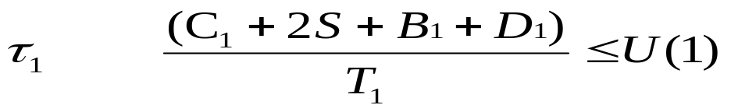
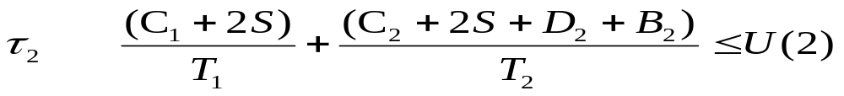
Task Switching and Pre-period Deadline and Blocking
Suppose that a task has D unit of preperiod deadline and blocking time B, we just add them to its execution time for each task in UB test. In exact schedulability test, we will move the deadline from T to (T - D - B).
Note that B₃ is always zero. It is the task with the longest period and therefore it cannot be blocked by a task with longer period.

Slide 61
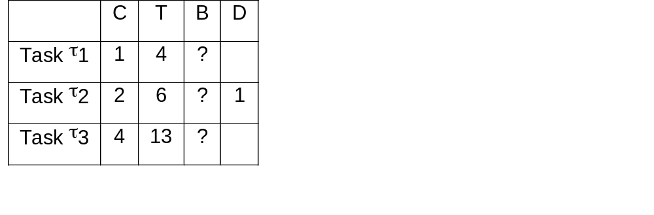
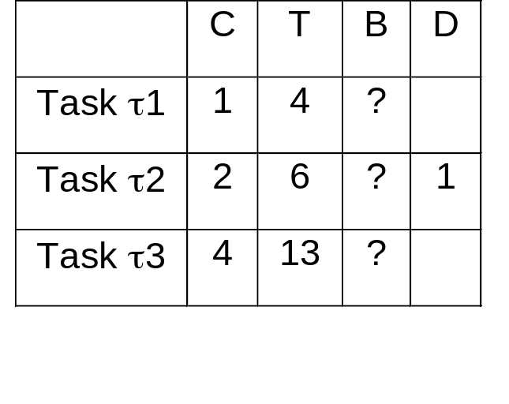
Sample Problem
Suppose that we have three tasks and there are one data structures shared by tasks τ₁ and task τ₂ and another shared by task τ₁ and τ₃. Task τ₂’s critical section is 1 unit long while task τ₃’s critical section is 2 units long.
Fill in the blocking times and determine if these 3 tasks are schedulable under PCP. (Note that the critical section is included in the C’s, because it is just the part of code that uses the shared data. )
Basic Priority Inheritance
Priority Ceiling Protocol

Slide 62
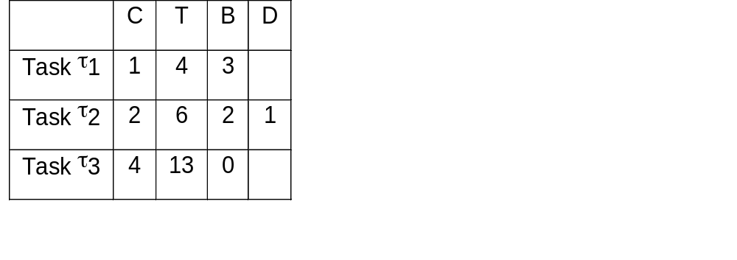
Blocking Under PIP

Slide 63
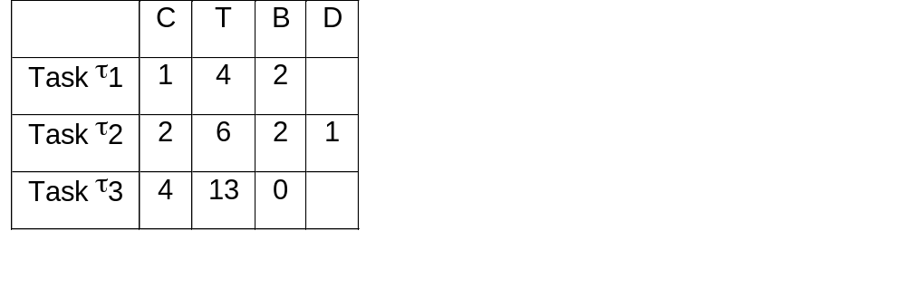


Sample Problem with PCP
B₁ = 2 = Max(2,1) because of the ‘block at most once’ property of PCP.
τ₁: a_{o} = 1 < (4-2) = 2 ok
a₀ = 1 + 2 = 3; a₁ = 2+ceil(3/4)*1 = 3 = (6-1 -2) =3. OK
a₀ = 1+2+4 = 7,
a₁ = ceil(7/4)*1 + ceil(7/6)*2 + 4 = 10
a₂ = ceil(10/4)*1 + ceil(10/6)*2 + 4 = 11
a₃ = ceil(11/4)*1 + ceil(11/6)*2 + 4 = 11<13 Ok

Slide 64
Summary
In the last lecture and today’s lecture, we have learned the issues in real time synchronization:
  the priority inversion problem
  the Basic Priority Inheritance Protocol
  the Priority Ceiling Protocol
  Schedulability analysis using real time synchronization protocol.
  direct blocking
  indirect blocking
Remember: When a task is in between a high and a low priority tasks sharing a lock, it can be indirectly blocked under both BIP and PCP.

